Slide 1
Fluid Administration/Nursing Care
a) VTDRG pgs. 359-367
b) CTVT pgs. 1154-1156

Slide 2
Normal Fluid Balance
The body is made up of approximately 60% water
This is divided into intracellular (2/3 of body fluid) and extracellular fluids (1/3 of body fluid)
The body maintains fluid balance (homeostasis) on a constant basis
Fluids are gained via:
  Oral intake
  Metabolism in the body

Slide 3
Indications for Fluid Administration
Dehydration
Shock
Loss of blood
Sx (surgical) procedure
  Potential of fluid loss or excessive blood loss
  Maintenance of blood pressure and perfusion
Disease that depletes the normal fluid, electrolyte or acid-base balances
  (polyuria, decreased oral intake of fluids)

Slide 4
Contraindications for Fluid Therapy
Conditions that carry a risk of pulmonary edema from fluid shifting into the lungs necessitate the need for caution and frequent monitoring
  Pulmonary contusions
  Existing pulmonary edema
  Brain injury
  Congestive heart failure
Overhydration
Adjust rates according to patient response to fluid therapy and veterinarian orders

Slide 5
Fluid Treatment Questions
How much fluid will be needed to rehydrate the patient, right now?
How much fluid will be needed to maintain the animals requirements?
How much fluid will be needed to compensate for ongoing losses?

Slide 6
Fluid Losses
Daily Maintenance Requirements
Ongoing Problems
A. Contemporary losses
  Vomiting
  Diarrhea
A. Sensible losses (measurable losses)
  Urine output
B. Insensible losses (inevitable losses)
  Feces
  Respiration
  Cutaneous losses

Slide 7
Physical Signs of Dehydration
Decreased skin turgor
Moistness of mucous membranes (MM). Are they moist, tacky or dry?
Decreased capillary refill time (CRT) Normal=1-2 secs
Rapid heart rate (HR)
Eyes sunken into bony orbits

Slide 8
What is the Skin Turgor test?
Assess the amount of time it takes for the skin to return to the animal’s body after gently pulling up into a “tent” along the back of the neck and along the spine
This test is not accurate in older animals or animals that have recently lost weight

Slide 9
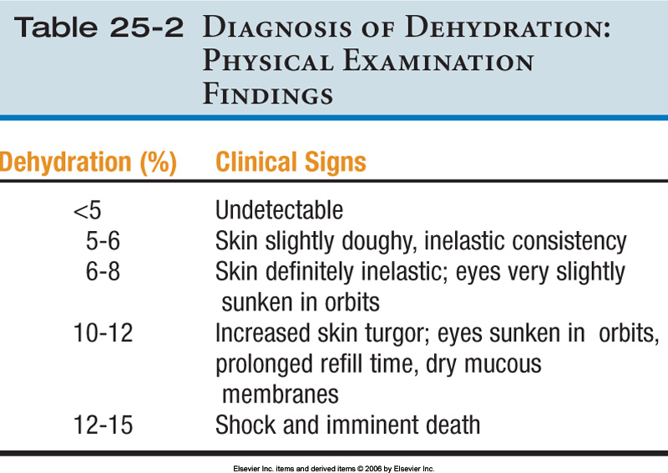
Pg. 790 CTVT
= Seeing with your eyes

Slide 10
Laboratory Dehydration Tests
Packed Cell Volume (PCV)
Total Plasma Protein Concentration (TP)
  PCV and TP will be elevated except in cases of severe hemorrhaging (they will be decreased)
Increased urine specific gravity (SG/UG)
Serial body weights (1 lb of body weight is equivalent to 1 pt or 480 ml of fluid)
Electrolyte assessment
  Only reflects dehydration if the kidneys are healthy
Note: Laboratory testing assists in detecting relative changes but does not reflect the absolute hydration status of the patient

Slide 11
Other indicators of Dehydration
Decreased urine output
  Normal production is 1 to 2 mL/kg/hr
Constipation
Cold extremities
Signs of shock including a rapid thready pulse, tachycardia, and tachypnea

Slide 12
Laboratory Assessment Values
*PCV Dog: 37-55%
*TP Dog: 5.4-7.6 g/dL
SG/UG Dog: > 1.035
*PCV Cat: 24-45%
*TP Cat: 6.0-8.1 g/dL
SG/UG Cat: > 1.040
↑ PCV=dehydration
↑ TP=dehydration
*THESE VALUES ARE ON PAGE 367 IN THE VETERINARY TECHNICIAN’S DAILY REFERENCE GUIDE

Slide 13
Routes of Fluid Administration
Oral (Minimal loss) Easy, cheap and safe.
Subcutaneous (Mild-Moderate dehydration) Never use >2.5% dextrose, as this will cause sloughing of the skin and abscesses
Intravenous (Severe dehydration; perioperative precaution) via IV catheter
Intraperitoneal (mild to moderately dehydrated; large volumes) This method is not commonly used and can be very dangerous if you accidentally hit an organ
VTDRG pg. 362

Slide 14
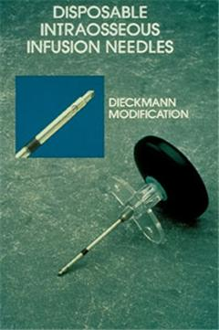
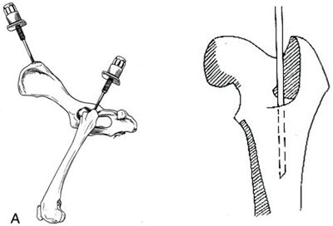
Intraosseous (head of the femur or humerus of small animals, neonates or animals with poor venous access) via 16 gauge bone marrow needle and other materials. IO infusion provides a direct conduit to the blood stream through the bone. This technique must be sterile!

Slide 15
ORAL ROUTE
CONTRAINDICATED:
Vomiting
Diarrhea
Shock
Dysphagia

Slide 16
Subcutaneous fluids are contraindicated when:
Infected or devitalized skin
Hypothermia
The patient requires dextrose
Severely dehydrated

Slide 17
Crystalloids –vs- Colloids
Crystalloids are aqueous solutions of mineral salts or other water-soluble molecules with variable electrolyte composition and contain no protein or colloids.
  Are in intravascular compartment for less than an hour
  Rapidly excreted in urine (if renal function is normal)
  Isotonic, hypertonic, or hypotonic
Colloids contain larger insoluble molecules, which act to retain existing fluid and promote movement of fluid into intravascular spaces
  Remain within the circulation.

Slide 18
Isotonic Crystalloids
Most common type of fluids used to replace body fluids
Can be administered via any routes
Cells not affected by this type of solution
  Normal Saline (0.9% NaCl)
    Contraindicated with cardiac disease
  LRS
    Not suitable with transfusions (can cause clotting/agglutination)

Slide 19
Hypertonic Crystalloids
Greater osmotic pressure than blood – thereby encouraging movement of fluid from cells into circulation
Administered for shock, cerebral edema
Cannot be given SC
Contraindicated with renal/cardiac failure
  NaCl (3, 4, 5, 7, 23.4%)
Should be given in combination with a colloid or isotonic crystalloid

Slide 20
Hypotonic Crystalloids
Lower osmotic pressure than blood – thereby encouraging movement of fluids into cells
Not to be used with shock/pulmonary or cerebral edema/
Examples:
  5% Dextrose in water (D5W)
  0.45% Saline
  2.5% Dextrose / 0.45% Saline

Slide 21
Subcutaneous fluids should always be …
Hypertonic
Isotonic
Hypotonic
Super hypertonic

Slide 22
Note: Don’t forget to warm fluids before administering; they are assimilated into the body better at body temperature

Slide 23
Types of IV Fluids Commonly Utilized

Slide 24
Various IV Fluids
Colloids
  Whole blood
  Plasma
  Dextran 70*
  Hetastarch
  Oxyglobin
  *Dextran 70 is a synthetic colloid utilized as a plasma expander to treat shock from circulatory collapse.
Crystalloids
  LRS
  Normosol-R
  Plasma-Lyte A
  Ringers Solution
  Sodium Chloride 0.9%-Normal Saline
  Dextrose 5% in Water (D5W)

Slide 25
General Rule of thumb
It is undesirable to mix multiple drugs in a syringe or intravenous fluids
Sometimes drug interactions are visible, other times they are not
Physical incompatibilities include precipitation and chemical inactivation

Slide 26
Volume Overload or Hypervolemia
Restlessness
Hyperpnea (abnormal increase in depth and rate of respiration but not to the point of labored)
Serous (watery) nasal discharge
Chemosis (edema of the ocular conjunctiva)
Pitting edema (remaining indented for a few minutes after removal of firm-finger-pressure. Over saturation of the cells.)

Slide 27
Causes of Volume Overload
Excessive total volume
Excessive rate of fluid administration
Decreased cardiac function

Slide 28
An animal with which condition is more prone to fluid overload?
Early renal disease
Parvovirus infection
Cardiac insufficiency
Very thirsty

Slide 29
If Volume Overload is Suspected
Auscultate the lungs for pulmonary edema – crackles can be heard
Obtain central venous pressures (pgs. 791-793)
Weight gain may be seen (Animals on a constant infusion of IV fluids should be weighed 3 times a day)

Slide 30
Fluid Rates
Maintenance Rate
Maintenance volume is the amount of fluid and electrolytes needed on a daily basis to keep the volume of water and electrolyte content normal in a well-hydrated patient
Remember insensible / sensible losses ?
40-60 ml / kg / 24 h

Slide 31
Let’s try it
A veterinarian prescribes a maintenance fluid dose (50ml /kg/24hr) via SC fluids. The patient weighs 40 lb. How many fluids should the patient receive?
1. Convert wt in to kg = 40/2.2 = 18 kg
2. Plug in wt (kg) into maintenace fluid calculation :
50 ml X 18 kg = 900 ml / 24 hr

Slide 32
Let’s Try It!
A veterinarian orders an 80# patient receive a maintenance dose of IV fluids (50ml/kg/24hr). How many ml’s will the patient receive per hour?
Convert wt (lb) into wt (kg)
80 / 2.2 = 36 kg
2. Determine 24 hour fluid dose
36 kg x 50 = 1800 ml (1.8 L)/24 hr

Slide 33
3. Determine how many ml’s the patient will receive in 1 hour:
1800ml / 24 hr = 75 ml / hr
This patient’s IV pump should be set at
75 ml /hr in order for it to receive the correct fluid rate

Slide 34
If you had no fluid pump, how would we determine how many drops per minute the patient will receive?
*Drip sets = 10 ml/gtt, 15ml/gtt 20ml/gtt, 60 ml/gtt
Let’s use a 10gtt/ml b/c big (macro)patient
Sooooooo…..

Slide 35

Free Drip Formula
ml / hr X gtt / ml = gtt / sec
3600 sec

Slide 36
Let’s plug in our information:
75 (ml/hr) X 10 (gtt/ml) = 750 gtt / hr
750gtt / hr = 0.21 gtt/sec
3600 sec
Not practical to count gtt / sec , so we multiply by 10 sec to get 2 gtt/10sec

Slide 37
Rehydration Formula
This formula is used for patients who are dehydrated and may or may not have ongoing losses (i.e. vomiting / diarrhea)
Ex. Parvo puppies, hepatic lipidosis felines
We also have to calculate ongoing losses
(estimated total amount / 24 hr)

Slide 38
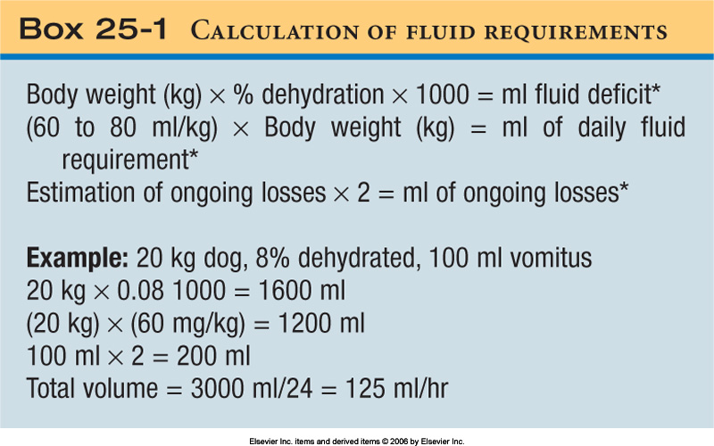
Calculation of Fluid Requirements
The volume of diarrhea and vomitus is frequently underestimated, so double the visually estimated amount to reflect the actual volume lost.
x
This is the fluid deficit.
ml
Daily fluid requirement-constant.
Multiply ongoing losses by 2 to get an estimate.
Add together for total volume to be replaced in milliliters over 24 hrs. Divide total volume by 24 hrs. to get hourly fluid rate needed for digital pump administration of continuous fluids. This is only for the first 24 hours

Slide 39
A patient that is 5% dehydrated needs IV fluids. He is vomiting about 20 ml . The maintenance rate is 50 ml / kg / 24 hr, the patient weighs 30 # and your drip set is 20gtt / ml. How many ml’s / hr should this patient receive?
% dehydration X wt (kg) X 1000 = A (deficit)
50ml x bw ( kg) = B (daily requirement)
Ongoing losses X 2 = C
Total amount to be infused = (A + B + C)

Slide 40
1. Convert BW to Kg’s : 30 / 2.2 = 13.6 kg
2. Plug in information into rehydration formula!
Fluid Deficit : 0.05 X 13.6 kg x 1000 ml = 680 ml/ 24 hr
Ongoing losses : 20 ml x 2 = 40 ml / 24 hr
Maintenance : 50 ml X 13.6 = 680 ml / 24 hr
Add it all together : 680 + 40 + 680 = 1400 ml / 24 hr

Slide 41

3. Determine how many ml ‘s / hr :
1400/ 24 = 58 ml / hr
Who wants to volunteer to calculate gtt / 10 seconds using a 10 gtt/ml drip set?

