Slide 1
Applied Dentistry for Veterinary Technicians
Periodontal Disease

Slide 2
Normal Periodontium
Remember which structures make up the periodontium?
Healthy gingiva has a sharp, tapered edge (margin) that lies closely against the crown of the tooth.
Epithelial attachment to the tooth crown forms the bottom of the gingival sulcus (moat around tooth/free gingiva, remember?).
Normal depth of sulcus ranges from 1 to 3 mm in dogs and up to 1 mm in cats.
Depth is determined with periodontal probe.

Slide 3
Periodontitis
Periodontics is the branch of dentistry concerned with the study and treatment of the periodontium.
Inflammation of the tooth’s support (periodontitis) is the most common disease in dogs and cats.
Periodontitis exists in most pets over five years of age that have not received home care, but can be seen as early as six months of age.
There are four stages of periodontitis.

Slide 4
The Culprit: Plaque
Plaque is a white, slippery film that collects around the gingival sulcus of the tooth. It is composed of bacteria, food debris, exfoliated cells, and salivary glycoproteins.
Over time, plaque will mineralize on the teeth to form dental calculus (tartar), a brown or yellow deposit that contributes to periodontal disease.

Slide 5
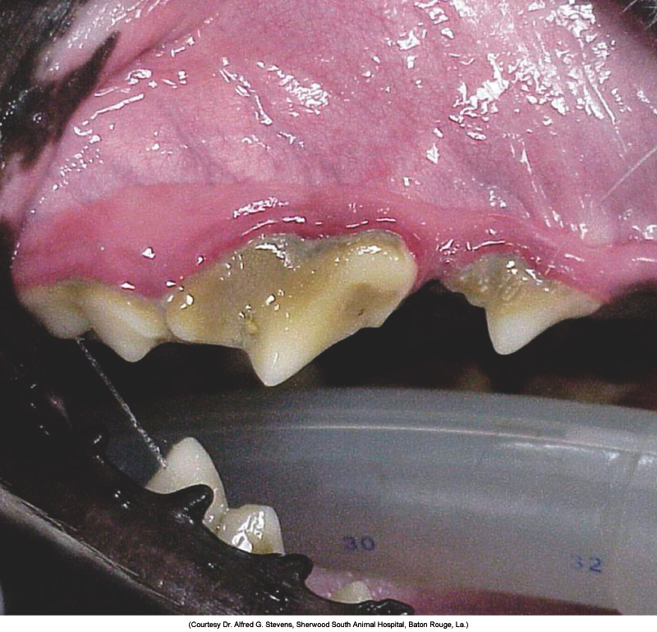
Calculus and plaque deposits on these teeth have caused the gingiva to become inflamed (gingivitis).
Plaque + Saliva=
Tartar/calculus
(mineralization of
Plaque/saliva)

Slide 6
As plaque and tartar collect around the tooth, they damage the gingival tissues by releasing bacterial endotoxins.
The animal’s immune system further damages these tissues through the release of harmful by-products from white blood cells as they attempt to destroy the bacteria.

Slide 7
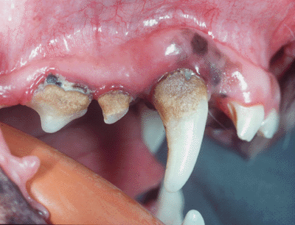
Periodontitis
Once present, destruction of the periodontal tissues has begun and will continue if not treated.
Once the periodontal ligament has been destroyed, it is extremely difficult to replace.
Timeline=months to years before the tooth actually falls out.
Organs effected: liver, kidneys, heart, and lungs.

Slide 8
Stage I Periodontitis
Also referred to as gingivitis.
Animal presents with reddened gingival tissues.
First thing that owners notice is halitosis (bad breath).
Time of onset depends on diet; can occur as early as 7 months of age.
  Canned food promotes gum disease.
  Hard, dry food generally better for gingival health.
Can be treated/cured with professional dental cleaning.

Slide 9
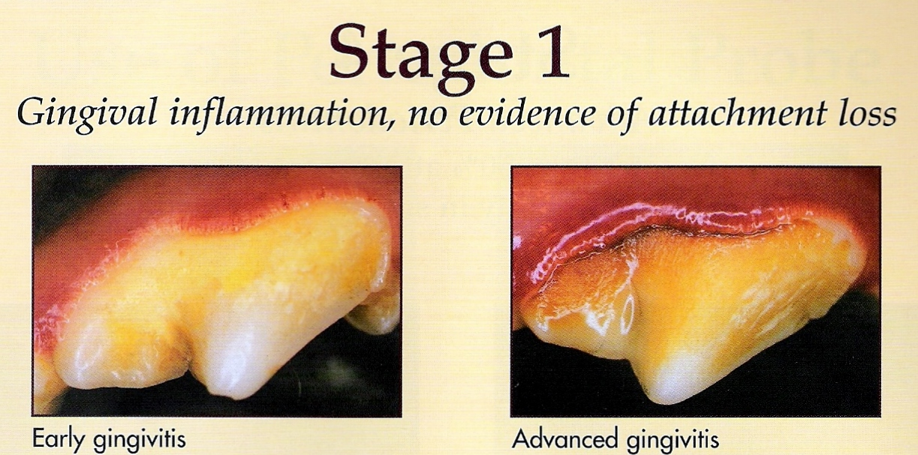
Stage I Periodontitis

Slide 10
Stage II Periodontitis
Early stage of gum disease; early periodontitis.
Examination will reveal inflammation and plaque at free gingival margin with edema present.
Bad breath = very apparent.
Most dogs between 1 – 4 years of age when stage II occurs.
With scaling, polishing, and home care this stage is treatable and usually curable.
Stage II can also be called advanced gingivitis.

Slide 11
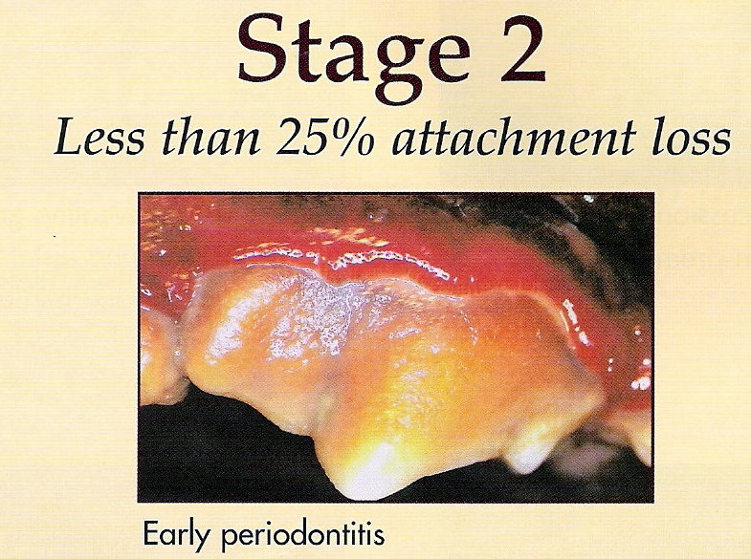
Stage II Periodontitis

Slide 12
Stage III Periodontitis
The established stage
Swelling, inflammation, and pocket formation (from attachment loss) are present.
Note: this stage is the change from gingivitis, which is reversible with treatment, to true periodontitis, which is merely controllable with therapy.
Bone loss can be seen on dental x-rays.
Patient presents with horrible halitosis.
Animals that suffer from stage III disease have owners who are not educated on, or cannot, or do not wish to perform home care.

Slide 13
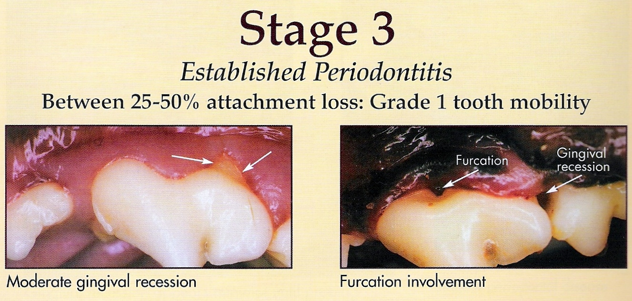
Stage III Periodontitis

Slide 14
Stage IV Periodontitis
Advanced Periodontal Disease
May appear as any or all of the following forms of pathology: severe inflammation, attachment loss and deep pocket formation, gum recession, bone loss, pustular discharge, or tooth mobility.
In addition to bad breath, these patients usually present with spontaneously bleeding gums.
The severe inflammation and pain, in some cases, will cause animals to rub their face, drop food while eating, and drool excessively.
Treatment consists of surgical extraction of affected teeth.

Slide 15
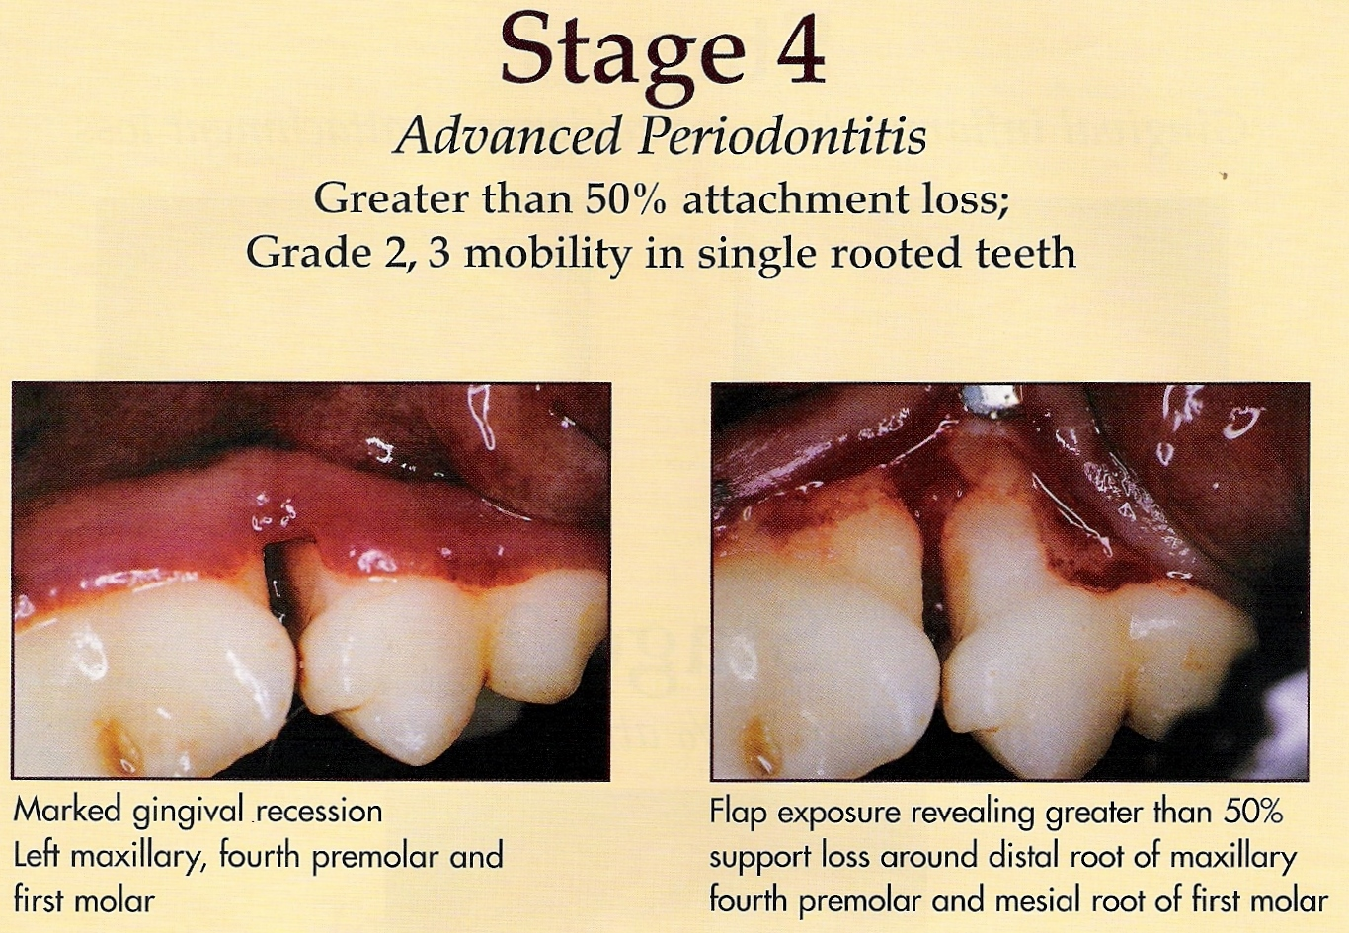
Stage IV Periodontitis

Slide 16
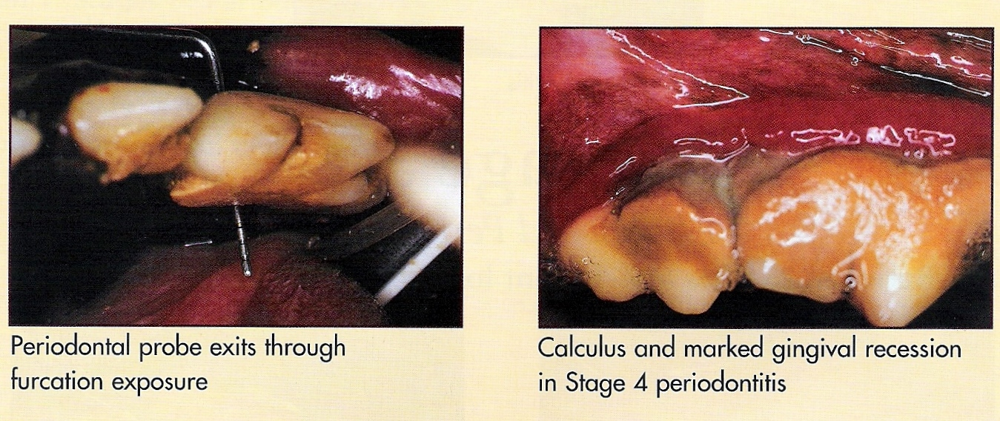
Cont. Stage 4

Slide 17
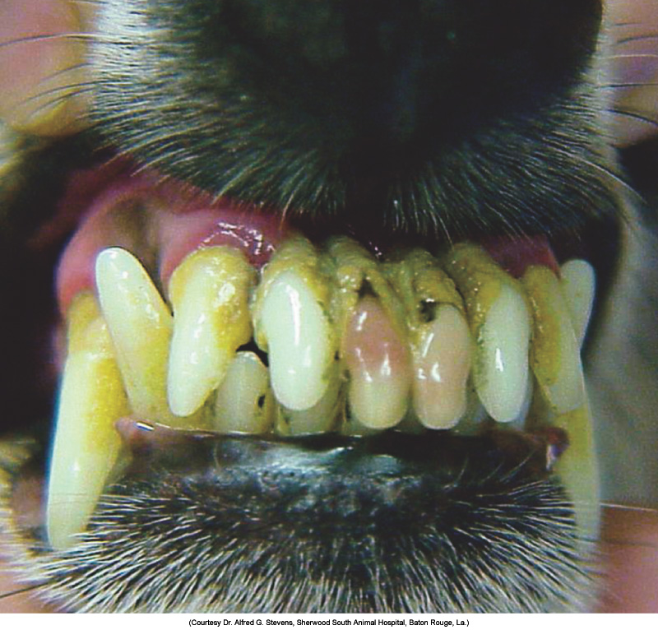
Stage IV Periodontal Disease
Periodontal disease has destroyed a significant portion of the alveolar bone and periodontal ligament of these incisor teeth. The gingiva has receded from the crowns of these teeth, and the tooth roots are now exposed.
This is an irreversible stage of periodontal disease!

Slide 18
Furcations
Furcations are areas between the roots of multi-rooted teeth and are indicative of periodontal disease.
Gum tissue recedes with advanced periodontal disease (grades III and IV) and bone supporting the tooth is “eaten away”, exposing the area where the roots come together.
Exposed section appears as a hole at the gingival margin.
Food and debris can build up in the lesion and lead to progression of periodontitis.
There are three classes of furcations.

Slide 19
Furcations
An explorer probe is used to grade the degree of furcation involvement.
Class I (incipient) furcation lesions exist when the probe can just enter the furcation area less than 1 mm. These do not show up on x-ray.
Class II (definite resorption) furcation lesions exist when the probe extends more than 1 mm horizontally into the area between the roots.
Class III (through and through) lesions usually indicate advanced perio disease. Explorer probe passes all the way through furcation. Surgery or extraction necessary.

Slide 20
Oronasal Fistulas (ONF)
Holes formed between mouth and nasal cavity, usually secondary to periodontal ligament destruction.
Tooth becomes mobile and eventually falls out, leaving a communication between oral and nasal cavities.
Maxillary canines commonly affected.
CS include sneezing, and persistent, usually single sided, nasal discharge with or without bleeding.
Treatment includes surgery.

Slide 21
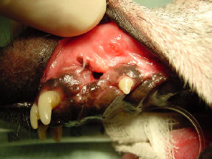
Oronasal Fistula

Slide 22
Gingival Hyperplasia
Thickening of gum tissue in an area.
Not a malignant (cancerous) condition.
May be caused by periodontal disease.
Boxers, Collies, Great Danes, Dalmatians, Labradors, and Rottweilers are prone.
Overgrowth of gingiva can increase sulcar depths, forming pseudopockets.
Treatment involves removal of excessive tissue and pathological assessment.

Slide 23
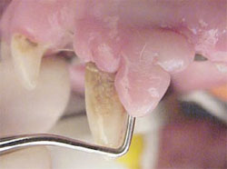
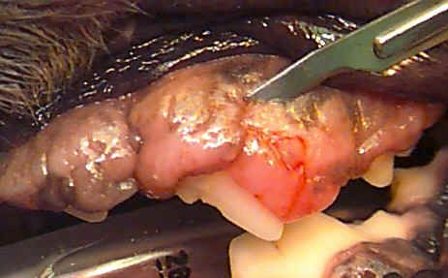
Gingival Hyperplasia

Slide 24
Stomatitis
Inflammation of the mouth’s soft tissues.
Includes inside of cheeks, tongue, and gingiva.
Can occur from many local and systemic causes including viral, fungal, and bacterial infections, kidney diseases, immune diseases, chemical irritants (acids), thermal (high or low temperature liquids ingested) or mechanical irritants.
Because of the many potential causes of stomatitis, a thorough history must be taken to plan diagnostic tests and treatment.

Slide 25
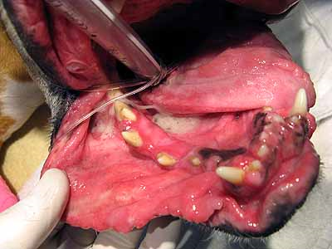
Severe Stomatitis

