Slide 1
Administration Routes in Small Animals
Special Topics

Slide 2
Routes of Administration
Oral (PO) (Non-parenteral)
Sublingual
Via feeding tube
Topical
Transdermal
Intranasal
Inhalation
Nebulized or volatilized
Rectal (PR)
Aural
Topical ophthalmic

Slide 3
Parenteral Routes: Administered with a needle and syringe
Intradermal (ID)
Subcutaneous (SC or SQ)
Intramuscular (IM)
Intravascular/
intravenous (IV)
Intraosseous
Intraperitoneal (IP)
Intra-arterial (IA)
Epidural/subdural
Intracardiac (IC)
Intramammary

Slide 4
Many factors are considered before the route of administration for a drug is selected. Some factors are based on the drug itself; other factors are based on the animal being treated

Slide 5
Drug Factors
Some drugs cause one effect when given parenterally and another effect when given non-parenterally (magnesium sulfate causes muscle relaxation when given IV and diarrhea when given orally)
Some drugs are insoluble in water and can be given IM but cannot be injected IV – Always be aware of label!
Some drugs are destroyed by stomach acid and cannot be given orally
Some injectable drugs must be given very slowly; while others must be given in a bolus

Slide 6
Patient Factors
Animals that are actively vomiting cannot absorb drugs given orally
Critically ill patients need to get therapeutic levels of drug into their bodies rapidly
The animal’s temperament must be considered
Can/will the owner medicate their animal at home properly with the medication as prescribed?

Slide 7
Other Factors to Consider
Is restraint going to be an issue?
What is your time frame?
Does this medication require that special precautions be followed during administration (i.e. gloves, mask)?
Potential side effects?
What is the most convenient route of administration for the owner?

Slide 8
Comparison of Common Parenteral Routes of Drug Administration
Intramuscular
90°
Intravenous
25°
Subcutaneous
45°
Intradermal
10°–15°
Epidermis
Dermis
Subcutaneous tissue
Muscle

Slide 9
Parenteral Routes of Drug Administration

Slide 10
Mini A&P Review of Skin Layers
The skin is made up of three layers: the epidermis, dermis, and subcutaneous layers The epidermis is several cell layers thick and does not contain blood vessels. Its thickness varies greatly from region to region in any animal and varies from species to species
The dermis is composed of blood vessels, lymph vessels, nerve fibers, and accessory organs of the skin (glands and hair follicles)
The subcutaneous layer (hypodermis) is composed of connective tissue and contains a large amount of fat

Slide 11
Always Gather Your Supplies First!
Needles
Syringes
Medication(s) to be injected
Cotton balls (or gauze) in alcohol (venipuncture only)
Vet Wrap, gauze or dry cotton balls
Muzzle or muzzles (E-collars can also act as great restraint devices)
Proficient person to restrain the animal
Hydrogen Peroxide (optional and if available)

Slide 12
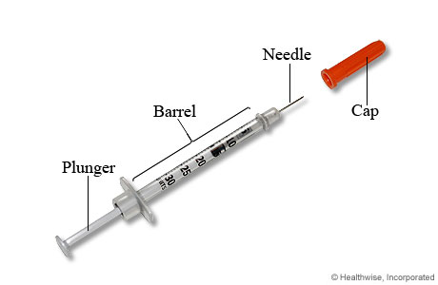
Anatomy of a Syringe
Bevel
Needle
Cap
Needle hub
Luer-lock tip
Barrel
Rubber stopper
Scale
Plunger
Flange
Thumb rest

Slide 13
Syringes are available in various sizes

Slide 14
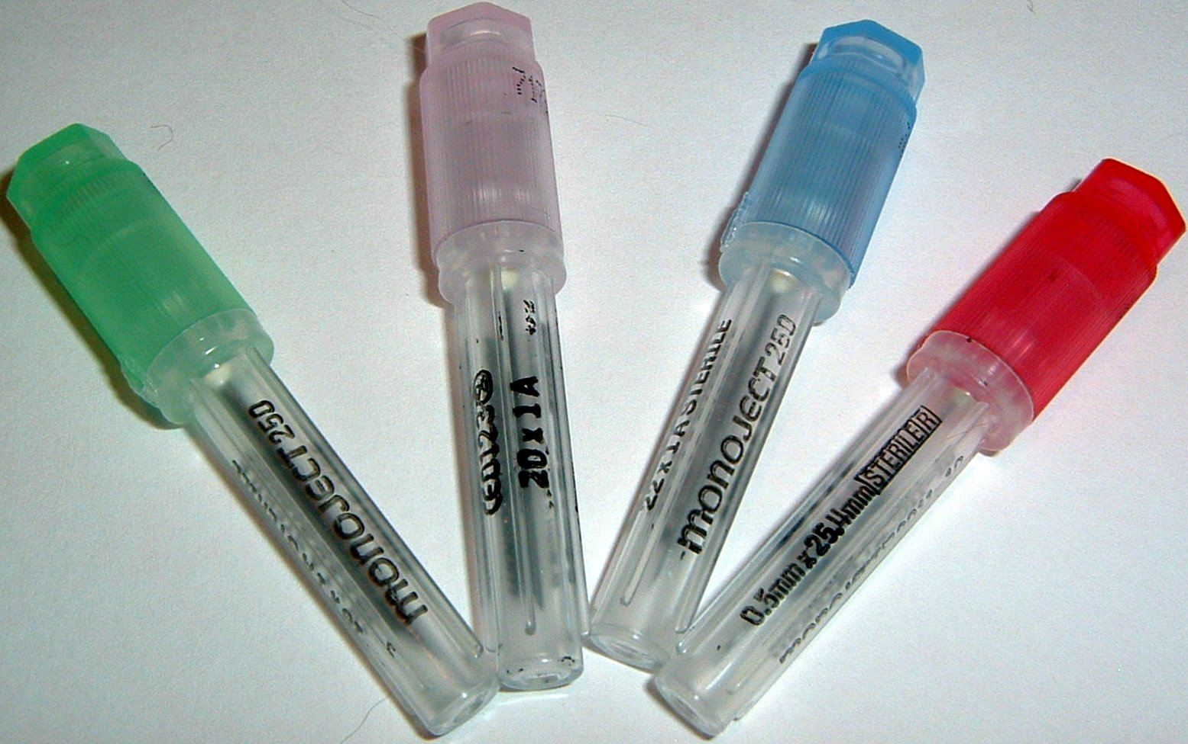
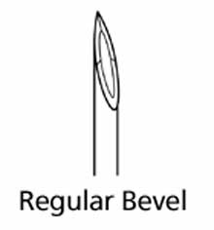
18 gauge x 1 in
25 gauge x 1 in
20 gauge x 1 in
22 gauge x 1 in
Various needles commonly utilized with injections
Please memorize the gauges in relation to their colors

Slide 15
Anatomy of a Needle
Shaft
Bevel
Point
Lumen
Plastic Sheath (Cap)
Hub

Slide 16
Injectable Drugs
Usually supplied as sterilized solutions, prepackaged syringes with needles for injection, powders that must be reconstituted with sterile solution, or in vials to be drawn up into syringes for injection
May be stored in ampules or (single or multidose) vials

Slide 17
Intradermal Administration

Slide 18
Intradermal Injections
Local anesthetics injected ID to desensitize skin
Allergy skin testing performed with ID injections
Most animals will not tolerate skin testing unless they are sedated
Skin must be shaved with a #40 clipper blade prior to administering injections for allergy testing

Slide 19
ID Allergy Injection Procedure
A fold of skin is lifted and a 25- to 27- gauge needle attached to a 1 ml syringe is inserted with the bevel up into the dermis
A 0.1 ml volume of allergen is injected
The injection site will look like a translucent lump if the injection is performed correctly
The skin is then examined for tissue reaction

Slide 20
Subcutaneous Administration

Slide 21
Subcutaneous Injections
Most easily and most frequently performed
Most common route for vaccine administration
Absorption rate may be slow in obese animals
Not recommended in severely dehydrated or critically ill animals
Good route for chronic, at-home fluid administration
Some substances are harmful if injected SC (>5% dextrose solution can cause skin sloughing)

Slide 22
SC Injection Sites
Preferred site for most SC injections is the dorsolateral region from the neck to the hips
In cats: the intrascapular region should be avoided because of the incidence of vaccine-induced tumors. Feline vaccinations should be administered in as distal a portion of an extremity as possible
Intrascapular region should also be avoided for insulin injections. Insulin should be injected in alternating sites along dorsolateral or ventrolateral aspect of trunk

Slide 23
SC Injection Procedure
Fold of skin is tented and the needle is inserted at the base of and parallel to the long axis of the fold
Do not insert needle perpendicular to the long axis, it may penetrate both sides of the skin and the medication (or fluids) deposited will be outside of the animal
Retract plunger of syringe slightly and check the needle hub for blood prior to injection
If blood appears in hub, remove needle and reinsert in another location

Slide 24
Skin Tent

Slide 25
SC Injection Procedure

Slide 26
SC Injection Procedure
After injection, briefly massage skin to facilitate drug distribution
If multiple vaccinations or medications are administered, injection sites should be a minimum of several centimeters apart

Slide 27
Intramuscular Administration

Slide 28
Intramuscular Injections
Appropriate route for injection of small volumes of medication
Generally, more painful for animals than SC or IV
Never use the muscles of the neck!
Avoid the sciatic nerve!

Slide 29
IM Injection Sites
Drugs are most often administered in the lumbosacral musculature lateral to the dorsal spinous processes

Slide 30
IM Injection Sites
In the semimembranosus or semitendinosus muscles of the rear leg
Needle should enter the lateral aspect of the muscle and be directed caudally to prevent penetration of the Sciatic nerve penetration can cause: pain and lameness

Slide 31
IM Injection Sites
Occasionally the triceps muscles on the caudal aspect of the front legs are used as IM injection sites

Slide 32
IM Injection Procedure
Gather all supplies needed.
Isolate the muscle between the fingers and thumb
A 22 to 25 gauge needle attached to a syringe is embedded in the muscle. As with a SQ injection, the needle hub is checked for blood before administration of medication to make certain a vessel is not inadvertently penetrated
Once in the muscle, inject the medication slowly
Massage the site for a few seconds after the injection to help distribute the substance if possible
(Immiticide injections are not typically massaged)

Slide 33
Intravenous Administration

Slide 34
Intravenous Administration
Drugs, medications, and/or fluids may be injected directly into a vein or through an IV catheter
IV route:
Predictable concentration of drug
Produces an immediate response
Rapidly reach high blood levels, achieving a rapid onset of action
Irritating drugs can be given IV (not IM or SC)
Increased risk of adverse effects (if drug is given too rapidly, not sterile, or improperly mixed)
In most cases, IV drugs should be given slowly
Make sure to remove all air bubbles in substance to be injected to prevent air emboli which can cause tissue damage or even, potentially death

Slide 35
IV Injection Sites
DOG
CAT
Cephalic vein
Lateral saphenous vein
Cephalic vein
Medial saphenous vein
The jugular vein is used to administer injections in both large and small animals IF an intravenous catheter is in place

Slide 36
IV Injection Instructions
Gather your supplies!
Expel all air bubbles from the syringe prior to inserting into the vein
Occlude the vessel with digital pressure or use a tourniquet
Grasp the extremity and pull the skin taut in a distal direction
Shave the fur and swab with alcohol or Swab the skin and hair with an alcohol-soaked cotton ball (go with the fur)

Slide 37
IV Injection Instructions (cont’d)
Insert a 22- to 25- gauge needle, bevel up into the vein
Usually blood enters the hub of the needle at penetration of the vein, BUT, placement is confirmed by aspirating the blood back into the syringe
Have the restrainer release pressure from the vein, and inject the syringe contents into the vein
Let the restrainer know that you are going to withdraw the needle, and apply firm pressure to the injection site until hemostasis/coagulation occurs (~1 minute)

Slide 38
About Tourniquets…
Most common: Nye Tourniquet or Penrose drain
Can be very dangerous used improperly
Goal is to visualize and access vein
Remove quickly!

Slide 39
Possible Complications with IV Injections
Injecting drug outside of vein
“Blowing vein”
Hematoma formation
Intra-arterial injection of drug
Hitting a nerve (pain, lameness, paralysis)
Air-embolus; other embolism
Septicemia

